Slide 1


Horizon Overview

Slide 2


Horizon Overview
Integrated SDLC Platform
Standardized Tools and Processes
Horizon is an SDLC enterprise platform that integrates a suite of tools designed to support agile software delivery.
The platform utilizes standardized tools and processes to streamline and automate manual functions in the software delivery lifecycle.
Automation of Delivery Process
Horizon automates the delivery process through the use of Continuous Integration (CI) and Continuous Delivery (CD) pipelines
The Horizon platform includes various tools that cater to different processes within the SDLC, enhancing overall efficiency.

Slide 3
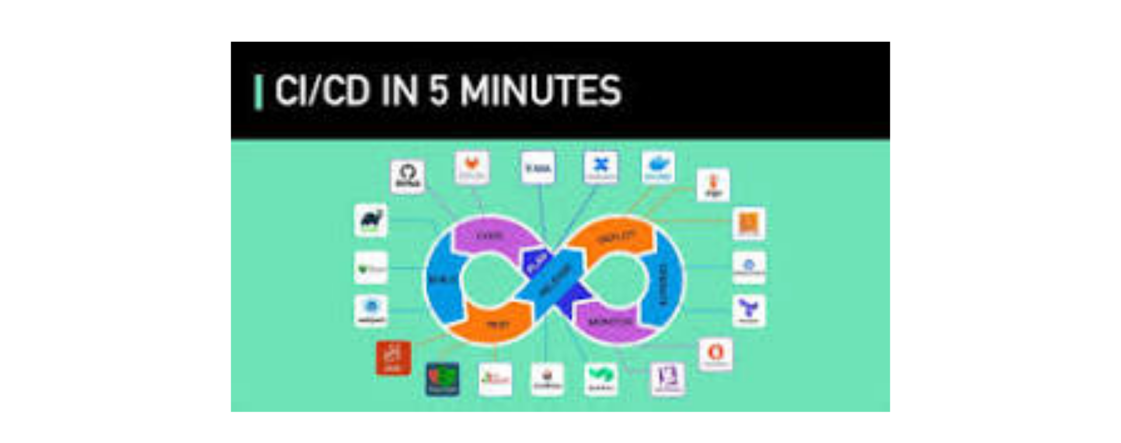
Innovation's Next Frontier
This image teases our innovative product, redefining industry standards.

Slide 4
Tools in Horizon Platform
Jira for Management
JFROG for Artifact Management
Used for planning and tracking releases for software agile teams.
Manages artifacts and dependency management.
Confluence for Collaboration
Datical for Database Automation
Facilitates team collaboration activities.
Used for deploying database changes.
Bitbucket for Code Management
Celestrial for Deployment Configurations
Stores code, controls versioning, and allows code review.
Manages deployment configurations effectively.
Jenkins for Build Automation
XLR for Release Orchestration
Utilized to build code and scan and test sets.
Plans, manages, and analyzes release pipelines.
Unit Testing Tools
Test Automation Tools
Various tools available for different technologies to ensure code quality.
Supports unattended automated testing successfully.
SonarQube for Code Quality
Used for code scanning and analysis to measure code quality.

Slide 5










Monthly Updates Process
Monthly Releases
Automated Testing
Every month or quarter, we release updates, focusing on new initiatives, adding features, and fixing bugs in the application.
We automate the testing for these new changes to ensure everything runs smoothly.
Application Integration
Impact of External Changes
Our test application is integrated with various upstream and downstream applications.
Changes in external systems can also impact our application, necessitating careful monitoring.
Data Flow Assurance
Change Verification
We need to ensure that data flows properly between systems to maintain integrity.
It's crucial to check that changes in external systems do not disrupt functionality in our application.

Slide 6





Test Automation Framework
Automating Deposits Testing
Ensures Functionality
Test Automation Tool
4
1
Guarantees that new features work seamlessly without affecting existing functionality.
Utilizes OpenText UFT Developer/LeanFT BDD Java framework for effective test automation.
Automatic Testing of Features
Focus on Deposits Space
3
2
Enables automatic testing of new features and changes in functionality.
Specifically designed for automating tests in the deposits area.

Slide 7





Continuous Deployment Process
Transition to Continuous Deployment Phase
Utilization of XLR
Ensuring Readiness for Release
1
2
3
XLR is used to automate the packaging and deployment of the software.
The process ensures that the software is ready for release at the end of the month.
Once everything is tested and works well, we move into the Continuous Deployment (CD) phase.

Slide 8










Efficiency with CI/CD
Reduction of Manual Work
Thorough Testing of Updates
Smooth Integration
Monitoring Changes in Connected Applications
Ensured Data Flow
CI/CD facilitates smooth integration of updates into the system, enhancing overall efficiency.
It ensures that the data flow between our system and other systems is functioning correctly.
Using tools like Litmus and XLR, we can significantly minimize manual tasks in our processes.
Every update, whether it’s a new feature or a bug fix, is thoroughly tested to ensure quality.
CI/CD helps us stay informed about changes in other applications we are connected to.

Slide 9
Q
Triggering Automation Scripts
A
When a developer makes a bug fix and commits the updated code to the repository, this triggers an event.
Jenkins Automation Process
Q
Jenkins Listening for Changes
A
Jenkins listens for changes in the code repository.
Q
Automatic Build Process
A
Upon detecting new code, Jenkins automatically starts a build process.

Slide 10

Build and Test Automation
Build process initiation
Feedback from Litmus
As part of the build process, Jenkins pulls the new code, compiles it, and triggers the test automation scripts.
Once the tests are completed, Litmus provides feedback on the testing results.
Test automation execution
Test results evaluation
The test automation scripts ensure the bug fix is tested automatically along with any other changes.
If the tests pass, everything is good; if they fail, Jenkins alerts the team to investigate and fix the issue.

Slide 11




Continuous Monitoring
Automated Testing Process
Integration of Jenkins and Litmus
Separate Git Repositories
Jenkins' Capability

Slide 12




Litmus Test Overview
1
2
3
Introduction to Litmus Test
Purpose of Litmus Test
Integration with SDLC
Litmus Test is a test harness tool developed as an in-house solution.
It is used for rapid testing and efficiency in the testing process.
Litmus Test integrates testing with build and deployment on the SDLC pipeline.
4
5
Validation of Events
Auto-Promotion of Code
It validates build and deployment events.
Litmus Test helps in auto-promoting developer code into the next environments.

Slide 13



Litmus Test UI Features
User Environment
Test Set Definition
Deployment Execution
1
2
3
Litmus Test provides a UI environment for users to define, classify, and pool execution machines or agents for testing.
Users can define test sets for scheduled execution, ensuring organized and timely testing.
Build deployment event-triggered execution via delivery pipelines to streamline the testing process.
Test Summary Reports
Success Criteria Definition
4
5
The UI allows users to view test summary reports, providing insights into the test outcomes.
Users can define success criteria for execution, ensuring tests meet specified standards.

Slide 14


Litmus Test Agent
1
Installed on user execution machines, the Litmus Test Agent is responsible for running automation scripts. It downloads scripts and automation code to machines for execution, and reports results back to the Litmus Test server.
Main Components of Litmus Test
Litmus Test UI
2
The Litmus Test UI provides an interface for monitoring the execution status and the agents.

Slide 15


Current State
Post Litmus Test
1.Manual checks and validations for build and deployment processes.
1.Checks and validations can be done automatically.
Achieving Target State with Litmus Test
Vs
2.Manual processes involved in executing automation scripts.
2.Automated execution of scripts is possible.
3.Immediate error detection and notification to stakeholders.
3.Error detection occurs post-event.

Slide 16




Litmus Integration in Continuous Delivery Pipeline
Whenever a deployment is triggered, Litmus is notified for automation execution.
Once deployment is complete, Litmus can trigger automation scripts on execution machines.
Notification for Automation Execution
Continuous Delivery Pipeline
Deployment Event
Triggering Automation Scripts
Configuration of Litmus
Deployment Trigger
Artifact Preparation and Deployment
Post-Deployment
In the continuous delivery pipeline, Litmus can be configured at build and release orchestration tools like Jenkins or XLR.
When a deployment event is triggered, artifacts are prepared and deployed into the targeted server using Ansible Tower.

Slide 17

20
mins
1.5
hours
4
hours
Maximum time allotted for Smoke Test Verification
Maximum time allotted for Suite of Functions Basic Test
Maximum time allotted for Function Regression Test
Types of Litmus Tests
The Smoke Test Verification must be completed within a maximum of 20 minutes, with a pass criteria of 100%.
For the Suite of Functions Basic Test, the maximum time allotted is 1.5 hours, with a threshold pass criteria of 90%.
The Function Regression Test has a maximum time allotted of 4 hours, with a threshold pass criteria of 70%. Execution results are valid as long as they are within the allotted time.

Slide 18



Roles and Permissions in Litmus Test
GES Group Alignment
1
Litmus Test utilizes the GES group in the Horizon platform to align access to the SPK’s user access.
User Access Validation
2
It validates user access at the SPK’s level but not at the repository level.
Permission Classification
3
Permissions are classified as Read and Write.
Read Permissions
4
Read permissions allow users to view information for SPK’s on the Litmus UI.
Write Permissions
5
Write permissions allow users to perform configuration and execution actions.

Slide 19
1
2
3
Jenkins Configuration
Code Commit Notification
Automation Test Triggering
Jenkins and Developer Code Repository Integration
Jenkins can be set up to monitor the developer's code repository.
When a developer commits new code, such as a bug fix, Jenkins is notified via a webhook or polling.
Upon detecting a new code commit, Litmus-XLR integration can initiate the automation test pipeline stored in a separate test automation repository.

Slide 20




XLR Workflow in Test Automation
Jenkins triggers pipeline
Jenkins detects the new commit and triggers the test automation pipeline by pulling the latest test scripts from the test automation repository.
1
2
3
Developer commits code
Tests are run
The developer commits code to the developer repository.
Jenkins runs the tests on the new developer code, and the test results are reported back.

Slide 21





Integration Configuration for Test Automation Repository
1
2
3
4
5
Configuration Details Required
Repository URL
Branch Information
Credentials
Build or Test Command
Include the URL of the test automation repository for integration.
Specify the branch information for the repository integration.
Provide the necessary credentials for accessing the repository.
Define the command to be used for building or testing the repository.
The test automation team must provide essential configuration details to the DevOps team.
6
7
8
9
10
Test Results Path
Build and Test Dependencies
Environment Variables
Test Execution Parameters
Post-Build Actions
Indicate the path where test results will be stored.
Specify the environment variables needed for the integration.
Outline the actions to be taken after the build process.
List any dependencies required for the build and test processes.
Detail the parameters required for executing tests.

Slide 22

Example of Jenkins Pipeline Configuration
1
2
3
Pipeline Definition
Agent Configuration
Stage: Checkout Test Automation Code
The pipeline is defined using the syntax 'pipeline { ... }', allowing for the configuration of various stages.
The agent is set to 'any', which means the pipeline can run on any available agent.
This stage checks out the test automation code from the specified Git repository using the main branch.
4
5
6
Stage: Install Dependencies
Stage: Run Tests
Stage: Publish Reports
In this stage, the Maven command 'mvn clean install' is executed to install all necessary dependencies.
The tests are executed in this stage using Maven with the command 'mvn test -Dcucumber.options="--tags @smoke"' to run specific tests.
This stage publishes the test reports by using the JUnit plugin to process the XML reports located in 'target/surefire-reports/'.

Slide 23
Summary of Integration Requirements for DevOps
Git Repository URL
Test Execution Parameters
Provide the Git Repository URL for test automation scripts and specify the branch name.
Outline the parameters needed for executing the tests.
Test Report Plugin Configuration
Build and Test Commands
Detail the configuration needed for the test report plugin.
Include the necessary build and test commands for automated execution.
Test Results Path
Specify the path where test results will be stored for review.
Dependencies
List the dependencies required for running the tests effectively.
Environment Variables
Provide any necessary environment variables that are applicable for the test execution.

